Slide 1

An Experiment on Algorithmic Ranking: User Behavior, Platform Incentives, And Policy
Dan Huttenlocher, Liang “Charles” Lyu,
Asuman Ozdaglar, James Siderius
Massachusetts Institute of Technology

Slide 2
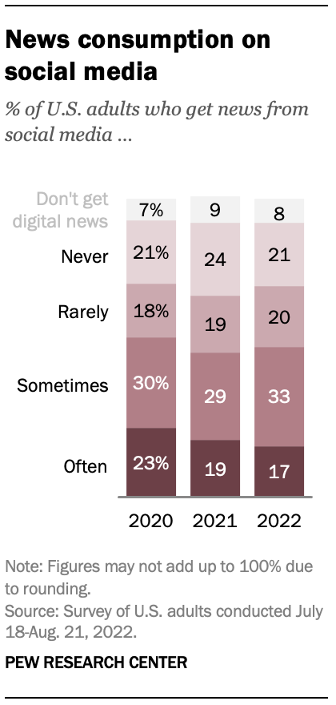
Social media and news
50% of Americans get news from social media “often or sometimes” [Pew Research Center ‘22]

Slide 3

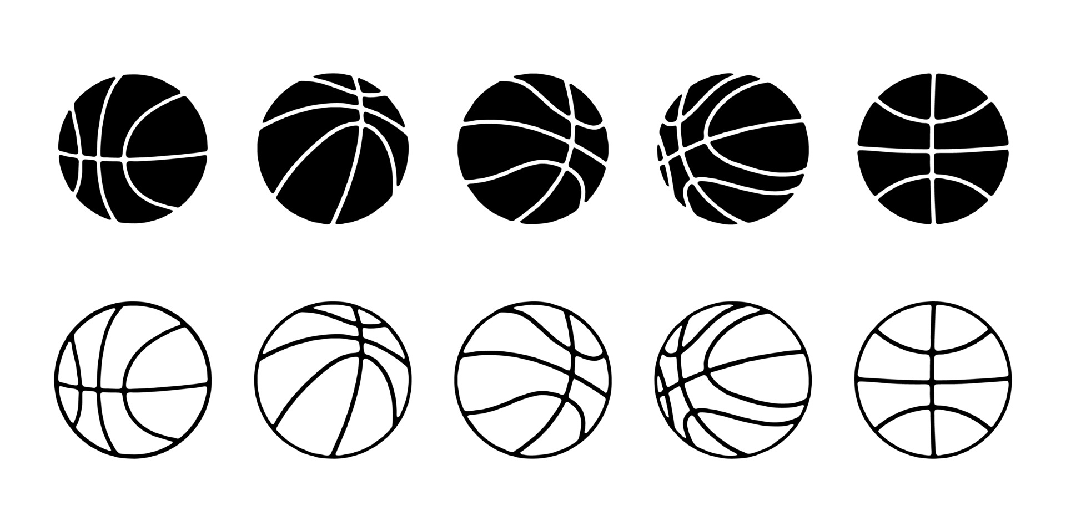





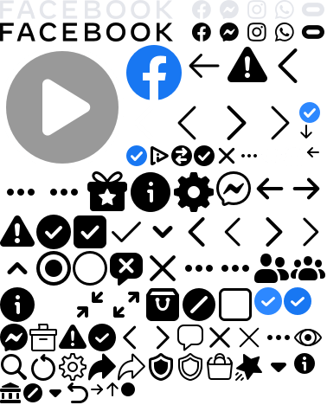
Ranking on social media
Recommendation and ranking algorithms:
“bread and butter” of social media feeds
Platform incentive: Maximize user engagement
Ad

Slide 4
Impacts of Algorithmic Ranking?
“Quantifying the impacts of algorithmic ranking is quite difficult, even with access to proprietary data. This is not only because of the complexity of these technical systems, but due to people’s complex and often strategic responses to changes in algorithms. ”
– Dean Eckles (2021), Testimony before the Senate Subcommittee on Communications, Media, and Broadband

Slide 5
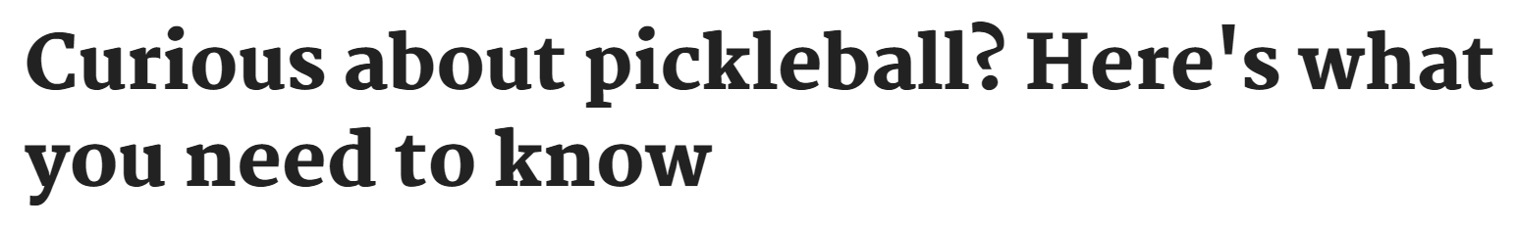
Benefits of Algorithmic Ranking
More engagement
More relevant information
Ad

Slide 6
Harms of Algorithmic Ranking
Lower variety
Echo chambers
Users encounter ~15% less cross-cutting content due to algorithmic ranking [Bakshy, Messing, Adamic '15]

Slide 7
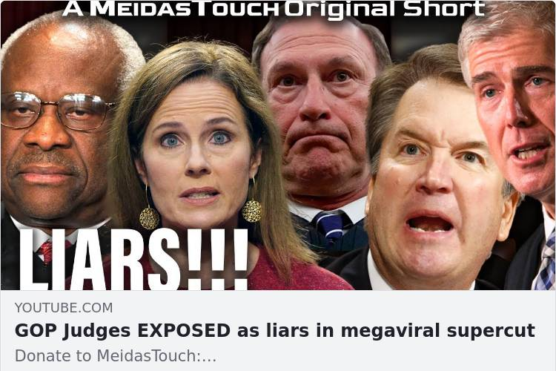
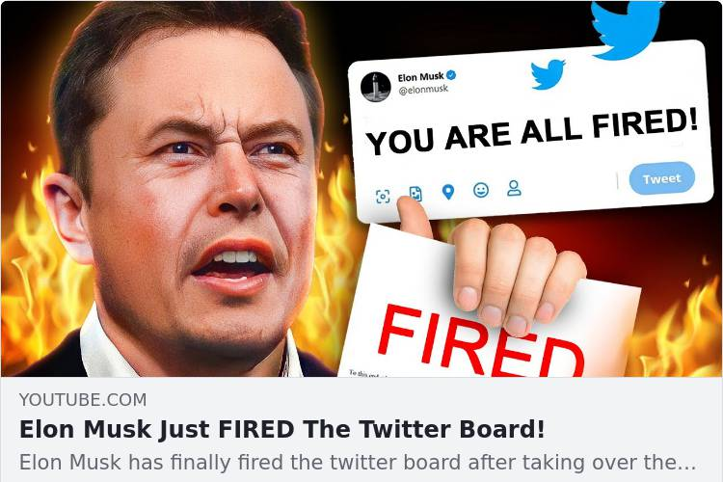
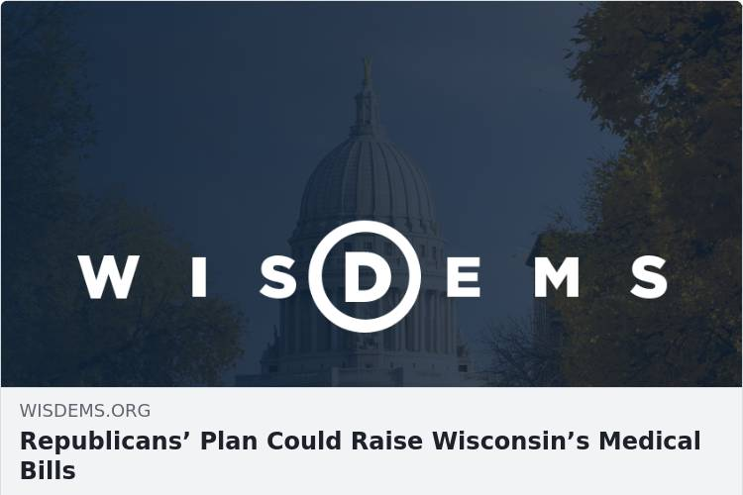
Harms of Algorithmic Ranking
Clickbait or sensational content
Misinformation

Slide 8
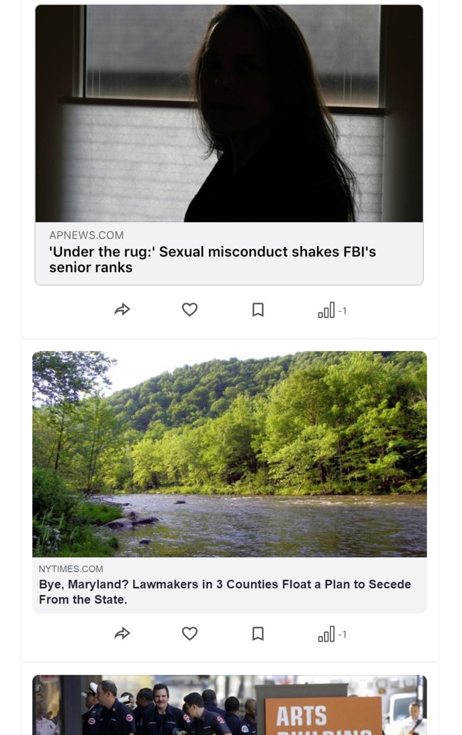
Yourfeed: An experimental news feed platform
Courtesy to Human Cooperation Lab (MIT Media Lab)
Users can like, share, etc
Also measures dwell time of each headline

Slide 9
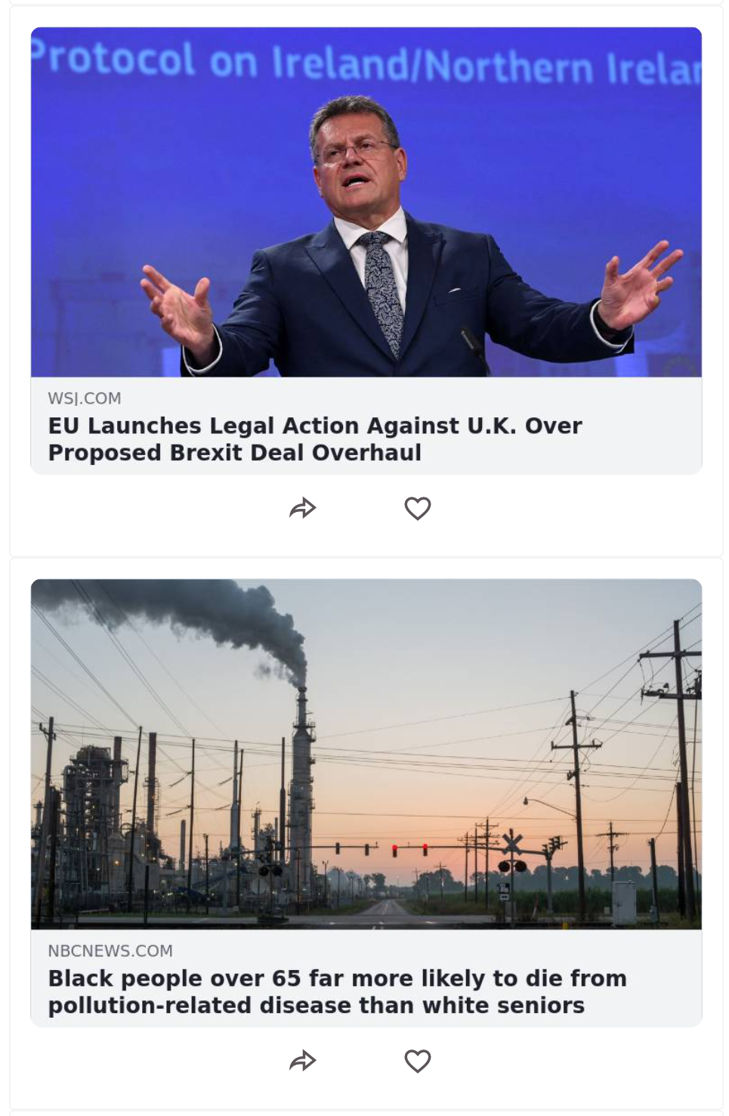
Our Experiment
Random Feed
Preference Feed
Friend Feed
Both

Slide 10
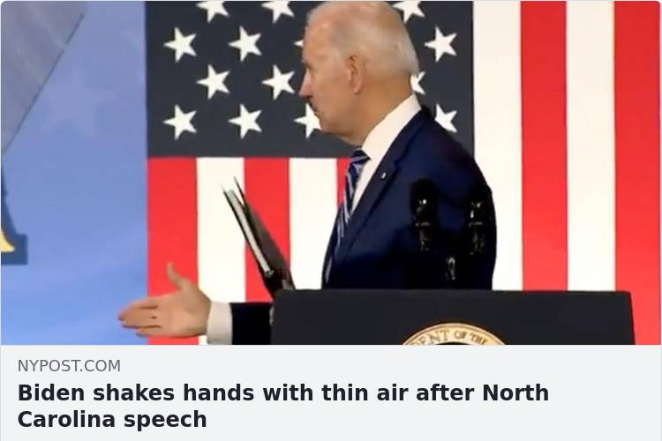
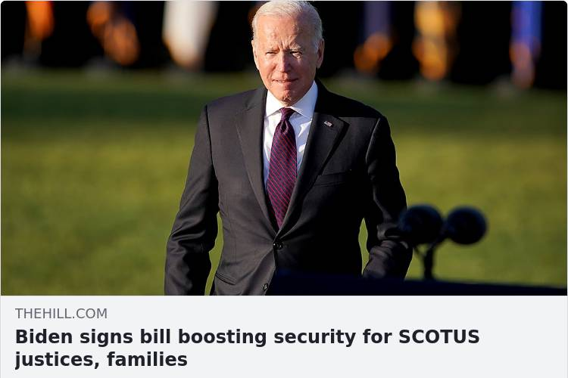
Our Goals
Effects of different ranking algorithms on engagement?
Misinformation vs informative content?

Slide 11
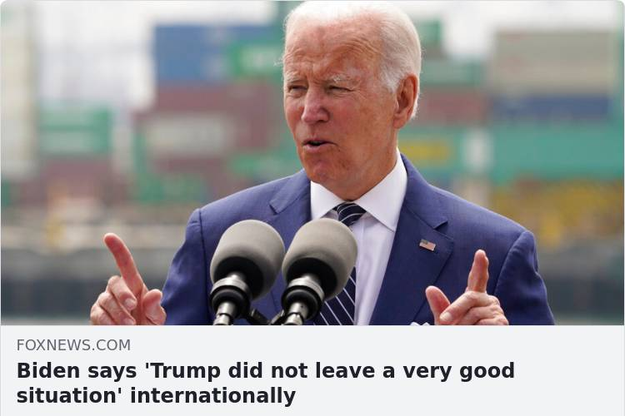
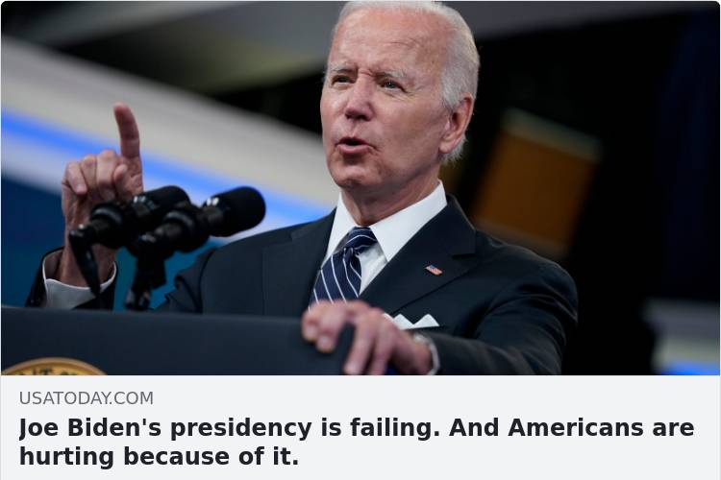
Our Goals
Effects of different ranking algorithms on engagement?
Misinformation vs informative content?
Ideologically congruent vs. incongruent items?

Slide 12
Our Goals
Effects of different ranking algorithms on engagement?
Misinformation vs informative content?
Ideologically congruent vs. incongruent items?
Friendships based on political ideology vs. other dimensions?

Slide 13
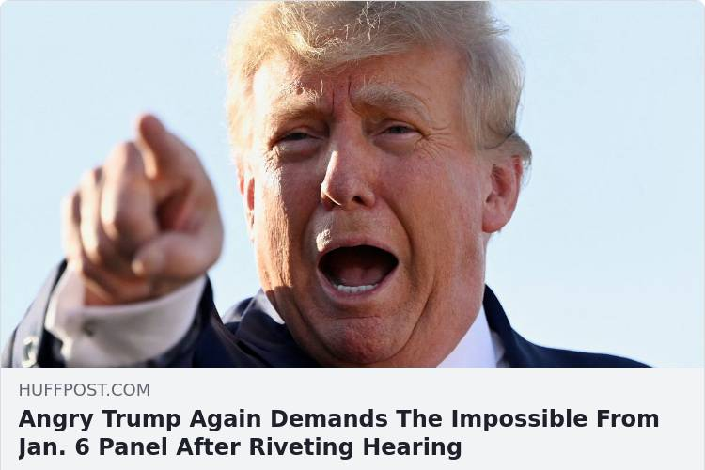
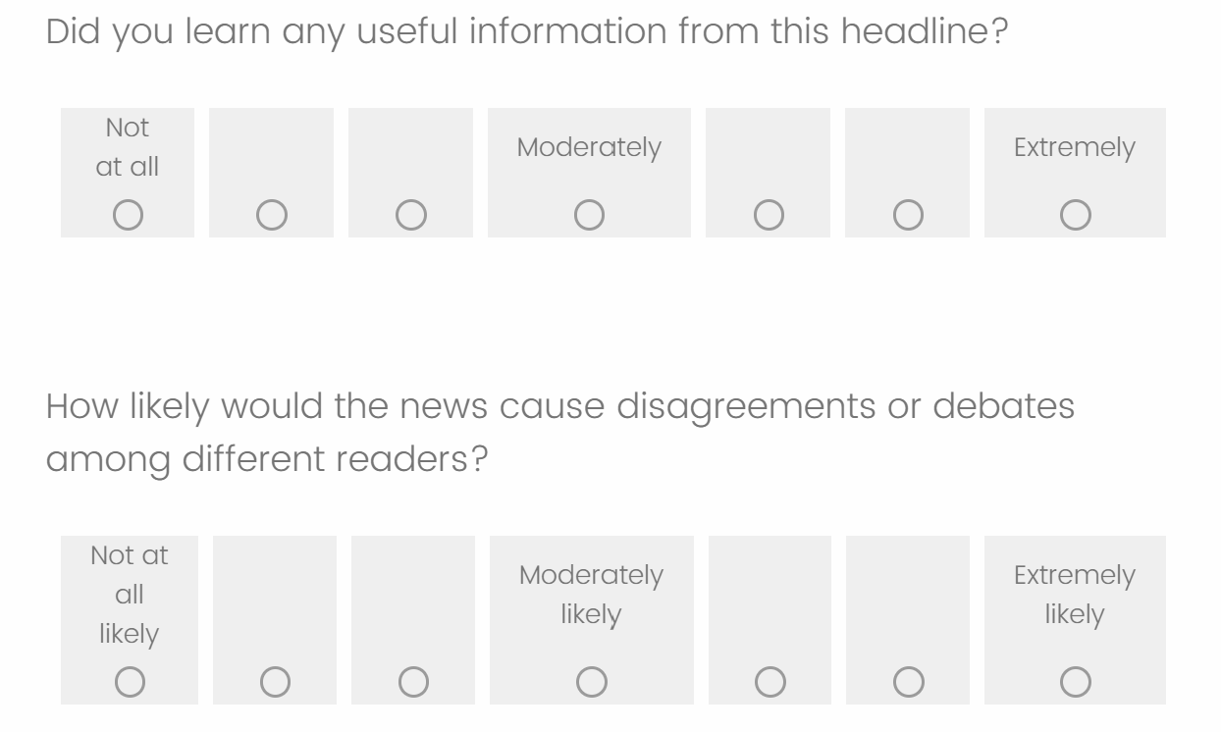
Wave 0: Crowdsourcing features for headlines
Veracity: 3.9 (out of 7)
Conflict: 4.8
Interest: 3.7
Surprise: 4.3
Relevance: 4.4
Topic: Politics
Democrat favorability: 4.9
Republican favorability: 4.3
Like: 3.7
Share: 3.9

Slide 14

Wave 1: Building social media “profiles”
Age: 18
Gender: Female
Identifies as Democrat
Hobbies:
Games: The Sims 4, Minecraft, Stardew Valley
Movies & TV Series: King of the Hill
Music: Car Seat Headrest, Death Grips
Collecting: Anime Figures, plushies
Sophie
Image by studiogstock on Freepik

Slide 15
Wave 1: Building social media “profiles”
Apolitical essay
“What are some things you do that you think nobody else would?”
Some things I do that I think nobody else would is to block the groceries after I take something off of the shelf. I like to push anything behind it further so that it makes less work for workers, and it also generally feels nice to do.
Political essay
“What are your thoughts on the Jan 6 capitol riots and the hearings? How much do you think Trump was responsible for this, and why or why not?”
I think the capitol riots were a really bad thing to happen. While I don't think Trump was directly responsible for it, the fan base he accumulated was not on accident.
Sophie

Slide 16
Wave 1: Building social media “profiles”
Random news feed of 50 headlines:
Liked 12 headlines
Shared 21 headlines
Spent 4.95 minutes on the news feed
Sophie

Slide 17

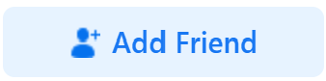
Wave 2: Measuring attention from ranking algorithms (Work in progress)
Random
Random
Preference
Friend
Both

Slide 18
Thank you!
lianglyu@mit.edu

